Slide 1
SDRAM Controller
Agreen Ahmadi
Intern in LEPS Group
PART 1

Slide 2
SDRAM CHIP

Slide 3
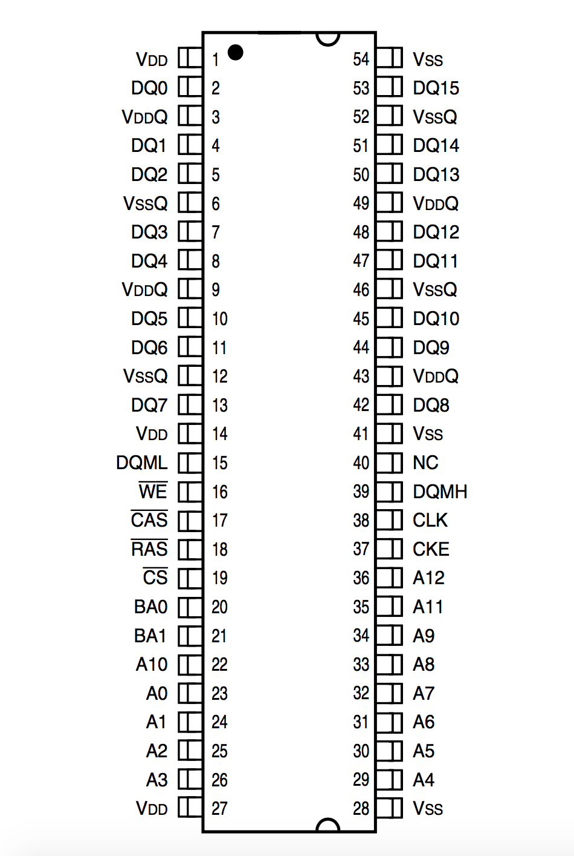

Slide 4
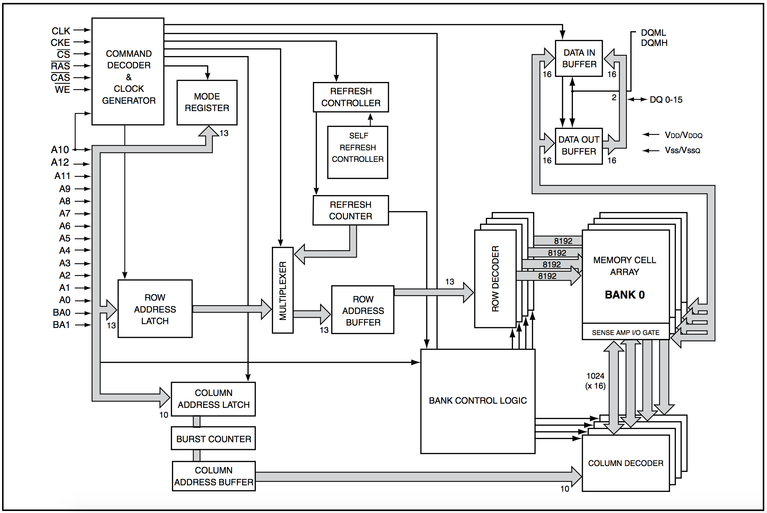

Slide 5
SDRAM COMMANDS
Device deselect (DESL)
No operation (NOP)
Bank activate (ACT)
Read
Read with auto precharge
Write
Write with auto precharge
Burst stop (BST)
Precharge select bank (PRE)
Precharge all banks (PALL)
CBR Auto-Refresh
Self-Refresh (SELF)
Mode register set (MRS)

Slide 6
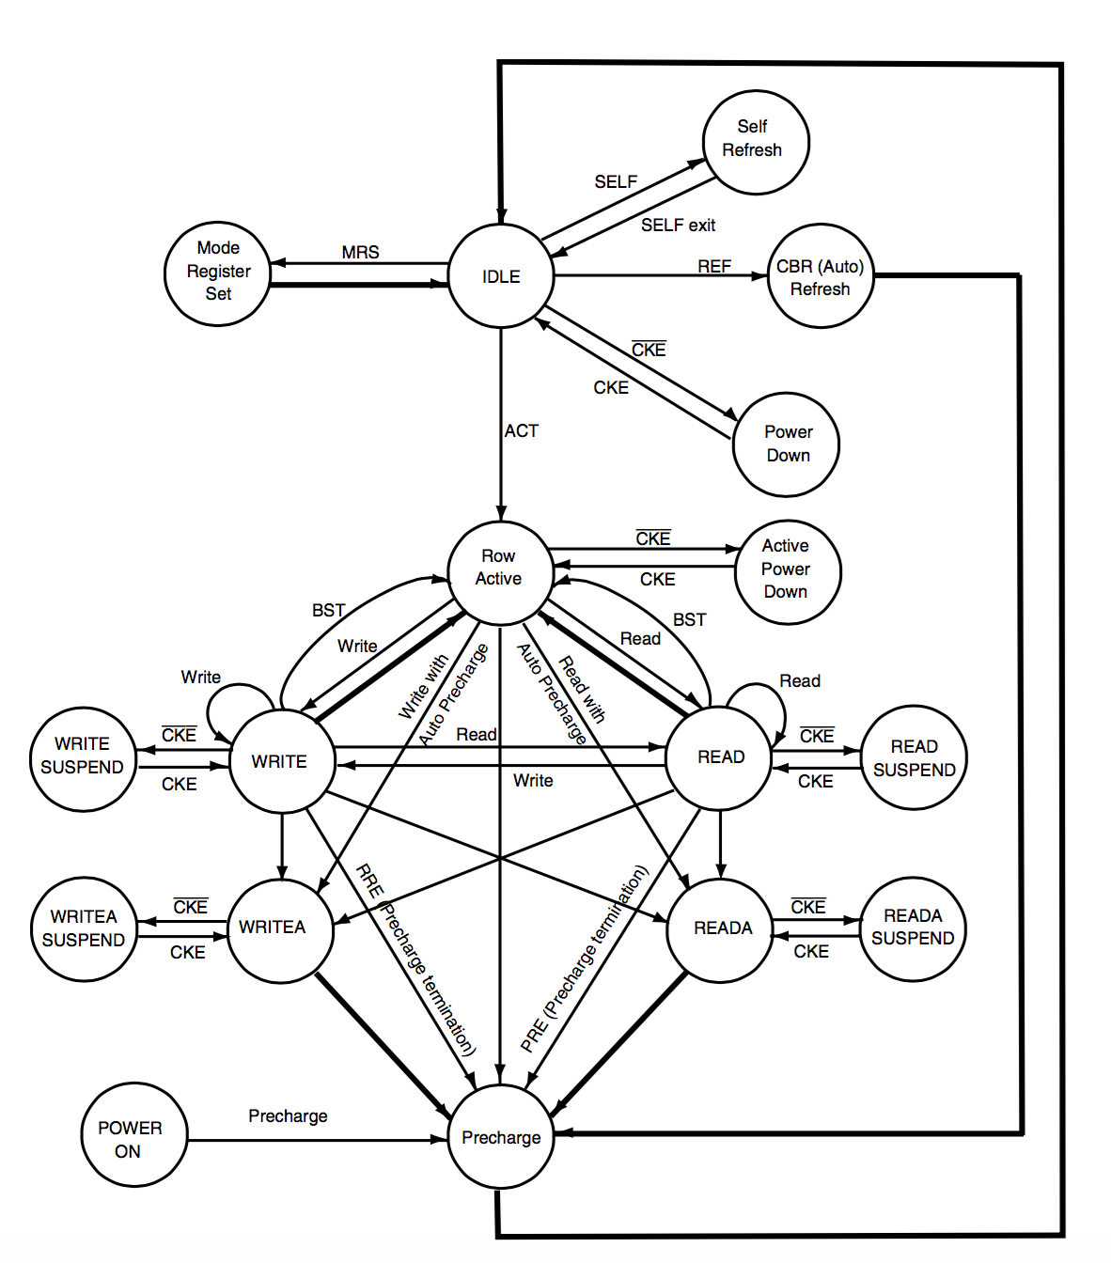

Slide 7
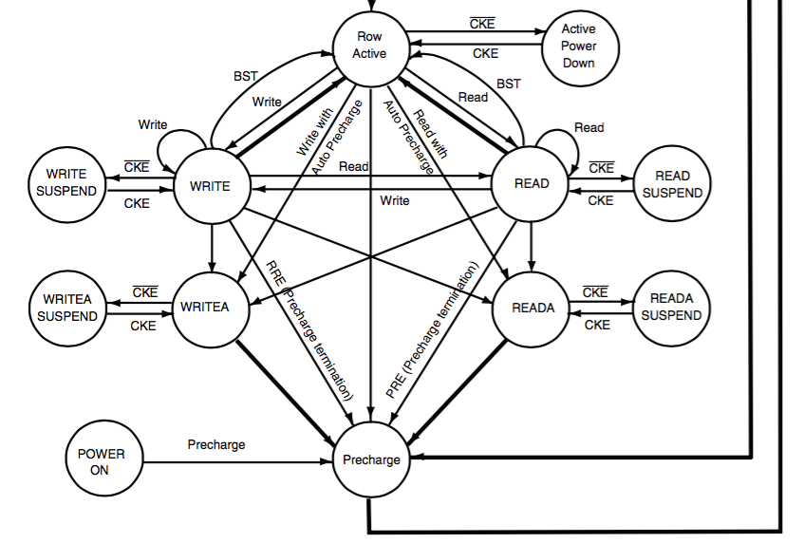

Slide 8
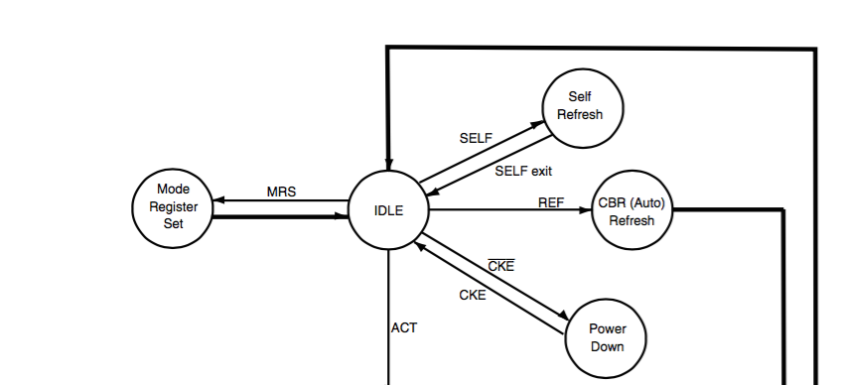
SDRAM STATE DIAGRAM

